Slide 1
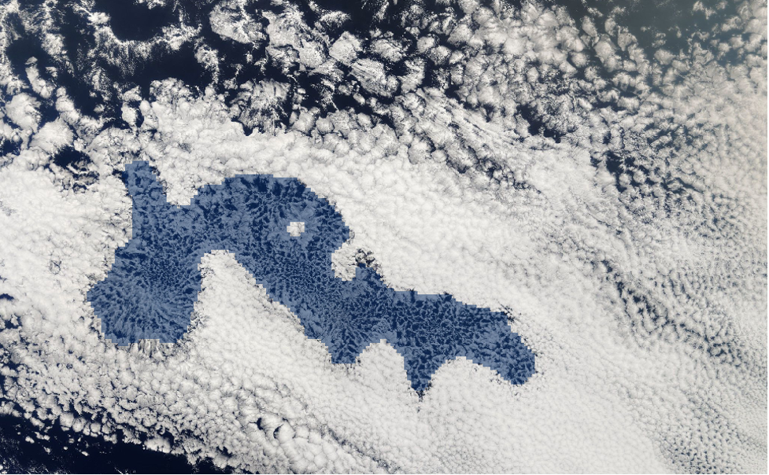

High Performance Computing:
Renewable Energy Solutions Continued
Kate Pendavinji
Notes:
Hello, my name is Kate Pendavinji and today I will be continuing our discussion on high performance computing and its utilization towards renewable energy solutions.

Slide 2
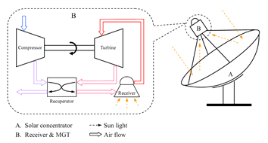
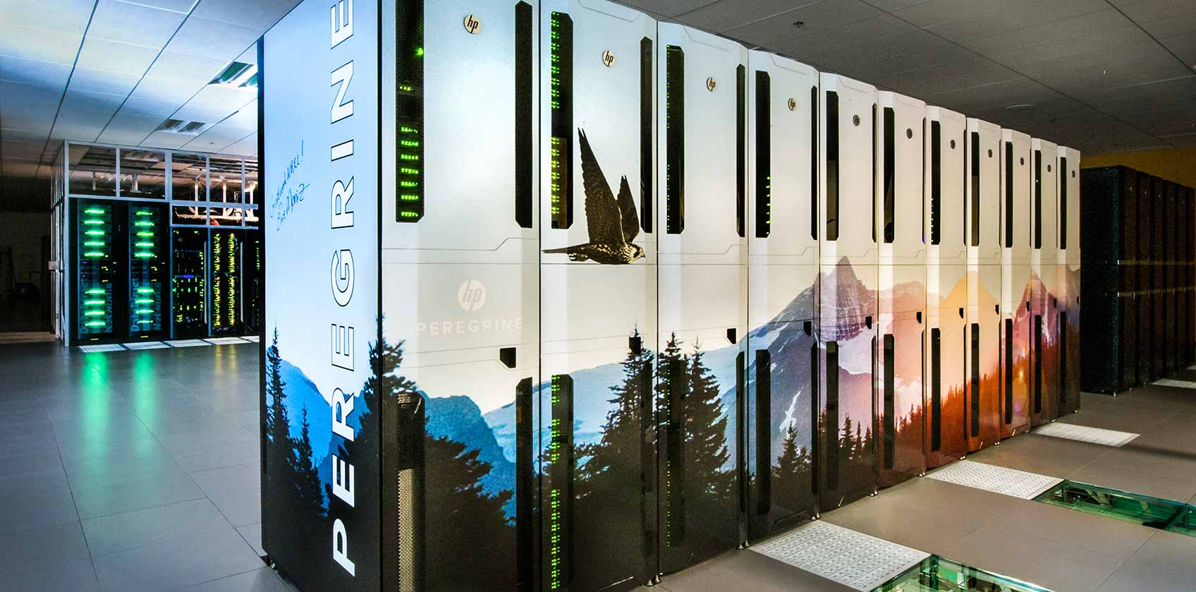
Recap
Initial solutions to renewable energy problems founded through OMSoP and the U.S. Department of Energy’s National Renewable Energy Laboratory’s Peregrine.
Live Green
Notes:
I will try to give a brief recap of the previous high performance computers we discussed last to lead into the actual future of HPC in renewable energy. So last time we extensively discussed topics surrounding climate change and the more recent need to arrive to technical solutions to environmental problems. The evolution of applications of high performance computing to renewable energy is a fairly short one, but one that is growing greatly with our need to arrive to technical energy solutions. Initially we discussed the early use of high performance computing for OMSoP which was able to use modeling through high performance computing to achieve their desired goal of combining solar power energy with micro-gas turbines to arrive to small scale use of renewable power. More importantly and recently we discussed the National Renewable Energy Laboratory or NREL’s Peregrine high performance computer which was used to run simulations in order to optimize issues surrounding renewable energy. We also discussed the retirement of Peregrine and its evolution to Eagle which is almost three times more efficient than Peregrine. The National Renwable Energy Laboratory is currently still using Eagle primarily but is set to come out . A large lingering question we were left with last time are we actually making progress toward renewable energy with these super computers and have they produced anything tangible?

Slide 3
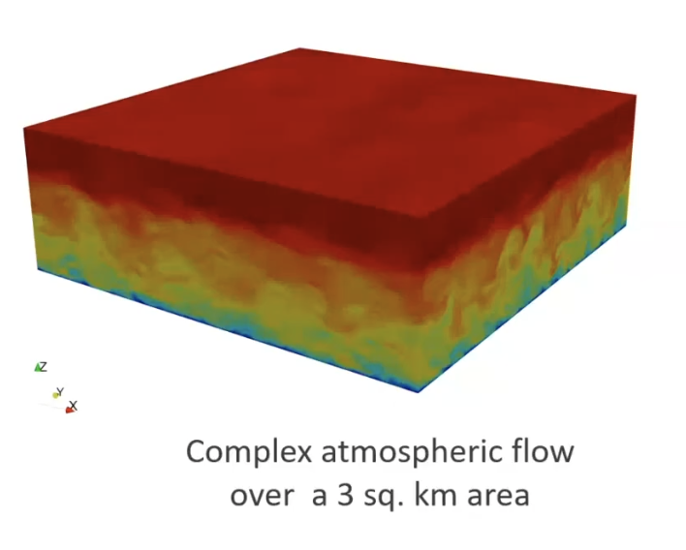
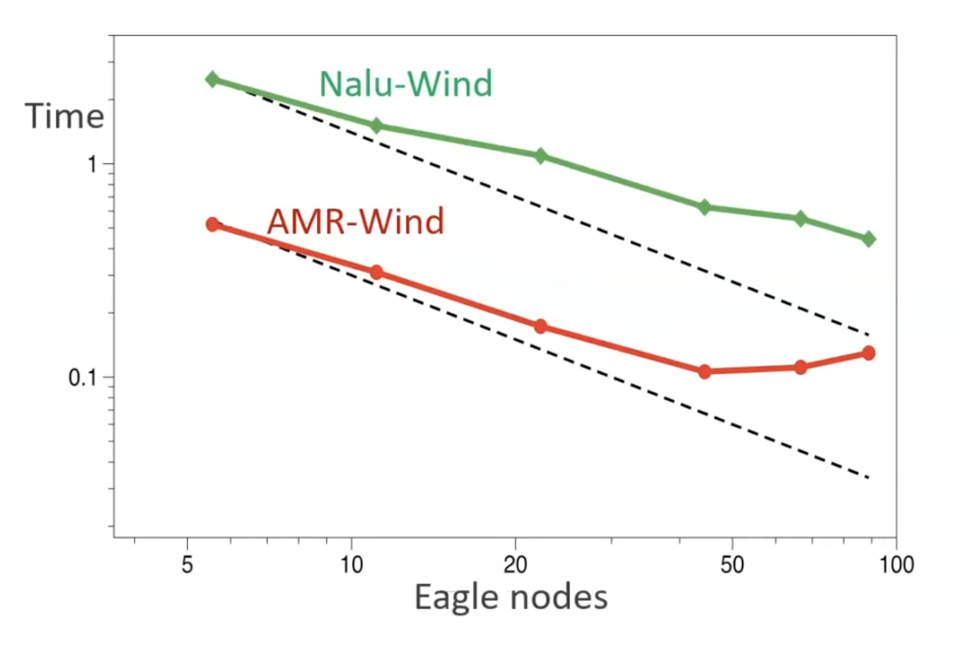
Eagle Wind Energy Simulations
Eagle & atmospheric boundary layer simulation
Nalu & AMR testing and making
Strong Scaling performance
Live Green
Notes:
Well to put it short, yes we do have tangible simulations. The National Laboratory of Atmospheric Researche’s high performance computer Eagle has been using atmospheric boundary layer simulations in order to understand the complex flow of wind. You can see the top diagram shows a representation of high speeds in red and low speeds in blue from top to bottom. This flow would be used to demonstrate flow that wind turbines experience when trying to design wind turbines for renewable energy and wind farms. NREL developed two different code bases to test these simulations caled Nalu and AMR. Nalu is described as quote unquote “a generalized, unstructured, massively parallel, incompressible flow solver for wind turbine and wind farm simulations”, and AMR is described as “a massively parallel, block-structured adaptive-mesh, incompressible flow solver for wind turbine and wind farm simulations” with clear differences being that AMR features the block-structure adaptive mesh. They test by starting with running these on lower amounts of compute nodes and doubling it every time. ASseen in the diagram Nalu performs much slower than AWR due to it being more general and unstructured where as AMR is considered structured. Overall this is how NREL is using their code bases to modernize wind energy and wind farms.

Slide 4
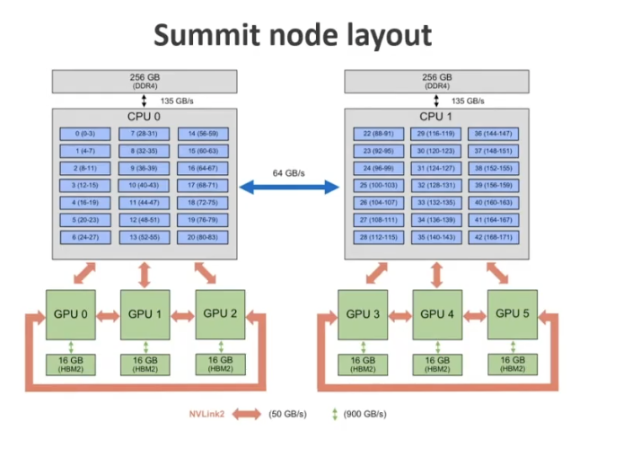
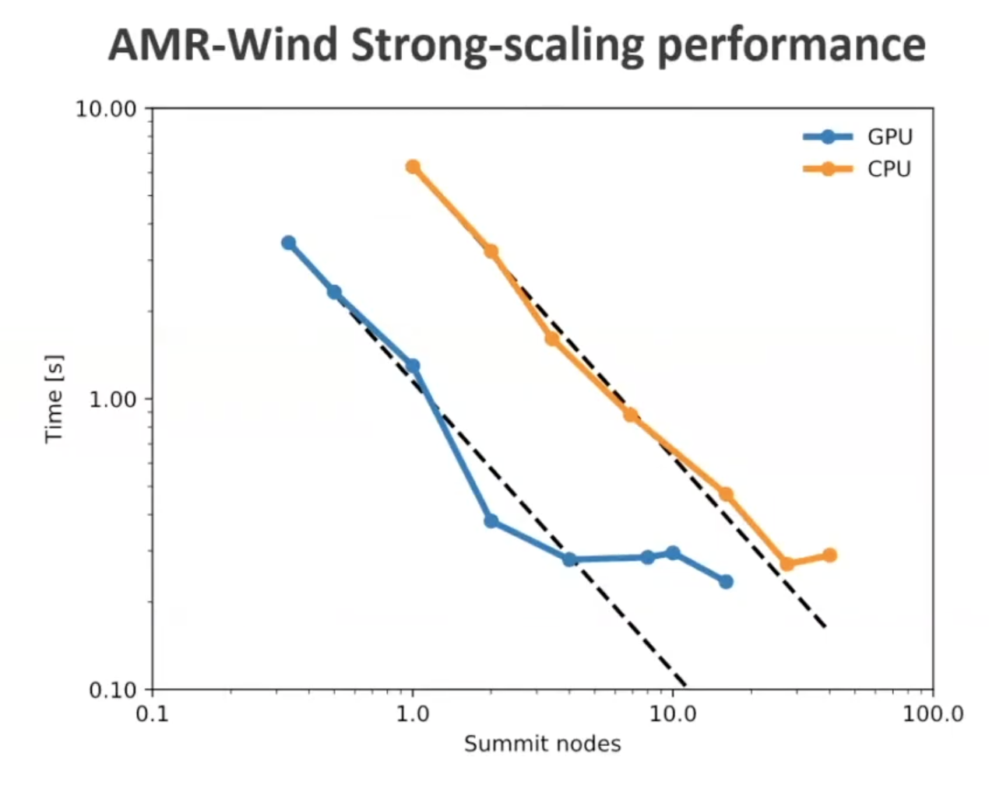
Summit Wind Energy Simulations
ORNL using AMR on Summit to see performance between GPU and CPU
Live Green
Notes:
We also discussed the Oak Ridge National Laboratory’s high performance computer Summit which was about 25 times faster NREL’s Eagle. Eagle featured traditional hardware which I showed in my previous demonstration. Summit on the other hand has started to utilize GPU’s a lot more which is what the figure above depicts. If you look at the Summit node Layout diagram above you can see the CPU’s which exist on normal workstations and in order to optimize renewable energy solutions we are trying to shift towards running more wind energy simulations on our GPU because most of computing power exists there. Summit is trying to move toward that. In the diagram you can see that since AMR was written by NREL for something with computing power more similar to Eagle that it functions more stably on the CPU’S. The GPU does not perform as far as ahead as the CPU as well. This is less important than the fact that GPU’s are about 10x faster than CPU’s at problem handling and can also tackle more complex problems all at once. These are two examples of the simulations we are seeing happening in real time on high performance computers, and how we are trying to shift the same code from older, slower high performance computing into newer versions such as exascale computing which we will get into later. I would like to also point out that you can find the Nalu and AMR code on github to look closer into what exactly they are using for all of these tests.

Slide 5

Titan Organic Photovoltaics Simulations
Live Green
https://vimeo.com/84985805?embedded=true&source=vimeo_logo&owner=2373684
Notes:
I thought it was worth mentioning that before Summit the Oak Ridge National Laboratory had another high performance computer named Titan which was also hugely focused on coming up with renewable energy solutions. Since most renewable energy discussion around HPC today is around wind energy and ExaWind more specifically I thought it would be important to mention something we saw a lot more of previously which is solar energy. It was retired in 2019, but featured incredible breakthroughs in Organic Photovoltaic Simulations. There was strong desire for super accurate and efficient configurations of solar cell models in order to make production of solar energy fast. Their idea was that developing these organic solar cells would be easier to reproduce than inorganic solar cells and cheapest for them to transfer onto polymer film for commercial use. I have this video of the models they produced which I think is really important because you can see a more visual development of how these high performance computers running all these calculations gives us a tangible solution.

Slide 6
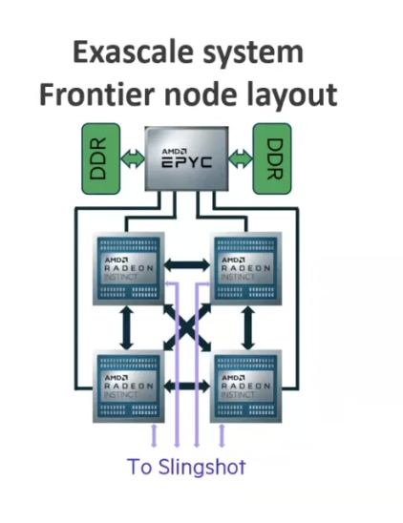
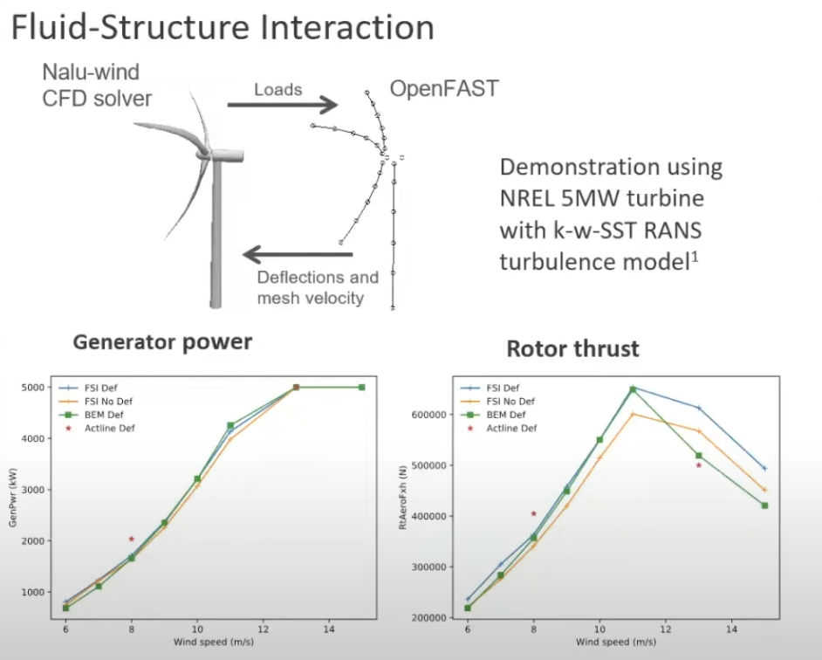
The Future: Exascale
Drastically different node layout to Summit and older high performance computers
https://vimeo.com/84985805?embedded=true&source=vimeo_logo&owner=2373684
Notes:
I mentioned the previous high performance computer node layouts before, but what high performance computing in general as well as high performance computing pertaining to renewable energy is moving towards is Exascale computing. Above is a diagram of The Oak Ridge National Laboratory’s first exascale computer Frontier’s node layout which is incredibly different to what we have seen with Summit, Eagle, and Peregrine. It provides for an exponentially faster system experience with the ability to do 1 quintillion calculations per second. The node layout will still utilize CPU’s and GPU’s and as we can see it will also use slingshot interconnect which is a just a low latency network architecture. Exascale computing is what the ExaWind project is based off of which is also what much of what I’ve discussed today is headed towards. The ExaWind project’s goal is to reach 30% of us electrical supply through wind energy. It hopes to do this through wind farm simulation and working with NREL to work on the physics of turbines and turbine blades and wind gusts again similarly to what I stated previously. You can see above how they used Nalu for that there’s a couple of graphs showing how they figured out rotor thrust.

Slide 7
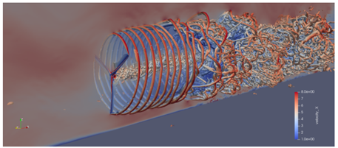
Frontier
Has yet to come out– set to be released in 2022.
Hopes to eradicate fossil fuels and look into going Nuclear.
Notes:
The Oak Ridge National Laboratory will be releasing their Frontier exascale computer this year. It is supposed to be their fastest high performance computer focused on attacking various topics such as medicine, climate change, renewable energy, and more. The idea and general word of mouth is that we will be able to produce wind turbines which are physically large and dense and placing them in ideal locations with large amounts of studied wind. In my previous presentation we saw off shore wind farms which we will continue to see as long as ExaWind continues to pursue their goal to make up one third of the U.S.’s energy. The image above is of a wind turbine simulation produced by NREL necessary for the ExaWind project. The Frontier video states that they are looking to use their climate predictions to completely eradicate fossil fuels and potentially use their technology to go Nuclear. Since Frontier is not yet released there aren’t a lot of intricacies like we have with aforementioned high performance computers working toward renewable energy. Once commercial use of Frontier begins I imagine we will see a lot of developments in renewable energy infrastructure! That’s all I have for tonight folks, thank you so much for listening!

Slide 8
Thank you!

Slide 9
References
https://insidehpc.com/2021/10/exawind-how-exascale-class-hpc-will-help-optimize-skyscraper-sized-wind-turbines-of-the-future/
https://www.exascaleproject.org/research-project/exawind/
https://www.olcf.ornl.gov/wp-content/uploads/2021/04/Glenski-Spock-Architecture-public-v4.pdf
https://www.olcf.ornl.gov/frontier/
https://www.olcf.ornl.gov/2013/08/21/titan-sheds-light-on-unknowns-in-organic-photovoltaic-research/
https://www.youtube.com/watch?v=6Ar_e6zUBhY
https://www.nrel.gov/computational-science/eagle-peregrine-infographic.html
https://www.nrel.gov/wind/assets/pdfs/future-of-hpc-webinar-2020-07-30.pdf
https://thenewstack.io/high-performance-computing-2022-exascale-for-all/
https://www.hpe.com/us/en/insights/articles/exascale-computing-what-it-is-and-what-it-could-be-2110.html
Live Green

